Slide 1
Mapping Relational Databases to Objects – Entity Framework and LINQ
CS 234N
Chapters 23 and 24

Slide 2
Topics
Intro to Entity Framework
Using Entity Framework to create classes for MMABooks
Using LINQ to query
One more version of CustomerMaintenance

Slide 3
Mapping DBs to Classes
Creating classes that read from and write to one table in a relational database is relatively easy. You did this in chapter 20 (lab 5) and again in lab 6.
BUT
Most relational databases contain dozens of tables and lots of the code is “boiler plate”.
Figuring out how to map the “dependent” tables to related classes is more complicated.

Slide 4
Mapping DBs to Classes
The class of development tools that are designed to solve the problem of mapping classes and databases are called Object Relational Mapping or ORM frameworks
ORM frameworks can be used to
Create a set of classes from a database
Create a database from a set of classes

Slide 5
Entity Framework
Is the .NET ORM framework
Your text shows you how to create a set of classes from a database in chapter 24.
The tutorial I gave you shows you how to create classes from a database you already have. It also shows you how to create a database from a set of classes you already have.

Slide 6
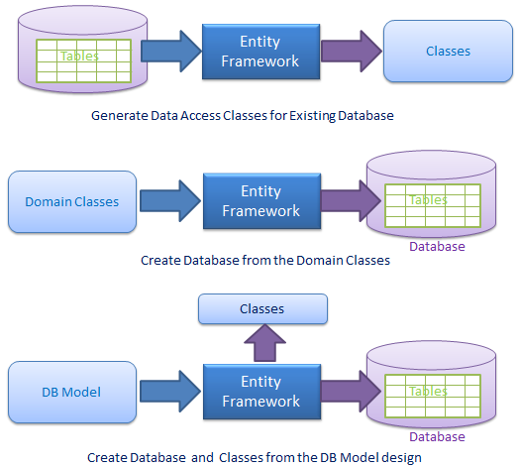
Entity Framework

Slide 7
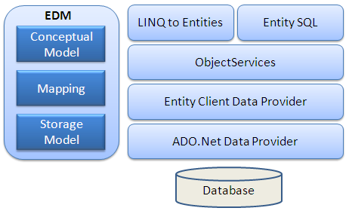
Entity Framework

Slide 8
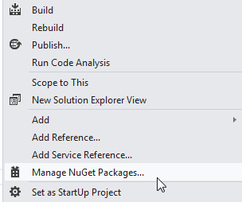
Lab 7
I’ve given you starting files for the lab. Entity Framework has already been added to the project but …
Sometimes you’ll have to add EF to a project by using the nuGet package manager.

Slide 9
Lab 7
Add an Entity Data Model to the project
Add a new Item
Data
ADO.Net Entity Data Model
Generate from database
You should have a connection (check the server explorer) to the MMABooks database already. Use that connection – Save in app.config
Map all tables for now
Accept defaults on the last step
Notes:
-

Slide 10
Lab 7
Let’s look at the model
What classes got created?
What properties does each have?
Look at the Table Mapping. Verify that columns and properties are related as you’d expect.
How are foreign keys handled?
State for a Customer
Customer for an Invoice
Notes:
-

Slide 11
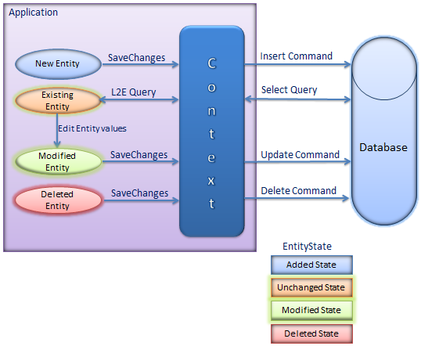
Lab 7
Let’s write a little bit of code. I want to fill a combo box and/or a data grid with data from the database. In order to do that I need an instance of a DbContext class that knows about my database.
Notes:
-

Slide 12
Lab 7
In this case, the class that’s inherited from DBContext is MMABooksEntity.
Let’s find that class.
Notice that it contains a property called Customers (States, Products etc)
Your textbook author suggests that you create a static class called MMABooksEntity that contains one static variable mmaBooks that is an instance of this class.
Let’s find that class
In order to work with objects from our database using this class we’ll write code that looks like MMABooksEntity.mmaBooks.Customers etc
Notes:
-

Slide 13
Lab 7
The DBContext class returns results as a set of objects
That set implements a number of interfaces including IEnumerable and IQueryable. Which means that you can use a technology called LINQ to filter and sort the objects much like you would do in a SQL statement. LINQ is discussed in detail in chapter 23.
Notes:
-

Slide 14
Lab 7
LINQ
Is a technology that let’s you “query” all kinds of data sources (a list of objects, a list of elements in an xml file, a list of records in a database) using ONE programming syntax.
That means that programmers only have to learn ONE language to perform queries on all kinds on things.
It means, for example, that you don’t have to learn SQL to query a database.
There are 2 very different syntax(es) for LINQ. The newest version uses lambda expressions. I’ll show you both.
At this point you should be able to read LINQ queries and write “simple” LINQ queries.
Notes:
-

Slide 15
Lab 7
LINQ - Get the list of states, sorted by statename
List<State> states =
(from state in MMABooksEntity.mmaBooks.States
orderby state.StateCode
select state).ToList();
List<State> states = MMABooksEntity.mmaBooks.States.OrderBy(
s => s.StateName).ToList();
Notes:
-

Slide 16
Lab 7
In the solution for lab 7, I’ve given you a simple form that you can use to test some LINQ expressions that I’ve written by binding the list of objects that are returned to a combo box or a data grid
Let’s look at the event handlers for Form1 together now.
I’ve given you lots of examples, from simple to more complex
I’ve also asked you to try a writing several linq queries yourself
Notes:
-

Slide 17
Lab 7
The rest of lab 7 asks you to build one more version of the CustomerMaintenance application using the classes generated by Entity Framework
Lots of the code is already written. You’ll add the code that’s specifically uses EntityFramework
Let’s start with the method GetCustomer on the main form
Instead of returning a list, this linq query returns ONE object. Use SingleOrDefault rather than ToList at the end of the query.
And then fill the state combo box on the add/modify form
Notes:
-

Slide 18
Lab 7
Now let’s try modifying records in the database. In every case, you’ll manipulate the EF classes and then ask the DBContext object to save the changes back to the database.
Notes:
-

Slide 19
Lab 7
Let’s try deleting.
Find the delete button event handler on the main form of the application.
Remove the selected customer from the collection of customers and ask the DBContext object to save the changes back to the database.
Notes:
-

Slide 20
Lab 7
Adding involves a similar process
Find the accept button click event handler in the add/modify form.
Create a customer object from the data entered by the user. Add it to the collection and ask the DBContext object to save the changes back to the database
Notes:
-

Slide 21
Lab 7
Last but not least, update
Find the accept button click event handler in the add/modify form.
The selectedCustomer object was already retrieved from the database and the DBContext still knows about it.
All you have to do is ask the DBContext object to save the changes back to the database.
Notes:
-

Slide 22
Next Time
That’s it for lab 7. The peer evaluation is a little different that typical. I’d like to see a screen shot of the EF generated classes as well as the LINQ queries we wrote together and the source code for the application that we wrote together. I’d also like a screen shot that illustrates the query form as well as the application running on your machine.
Please let me know if you intend to take quiz 2 during the final exam time on Tuesday of finals week.
Anyone interested in a social event?

